Slide 1
Esquina Noroeste

Slide 2
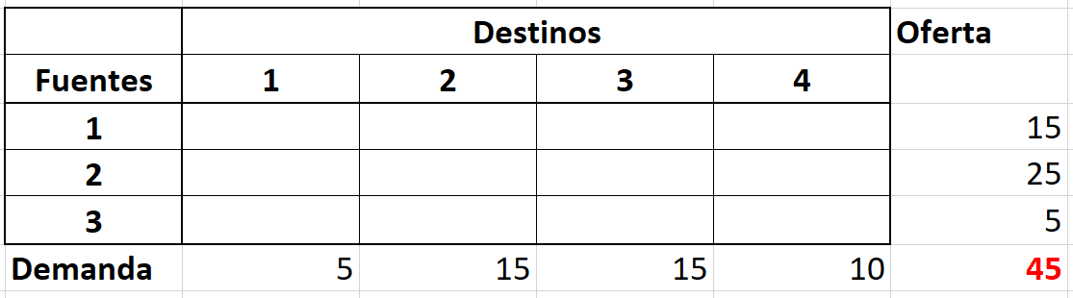
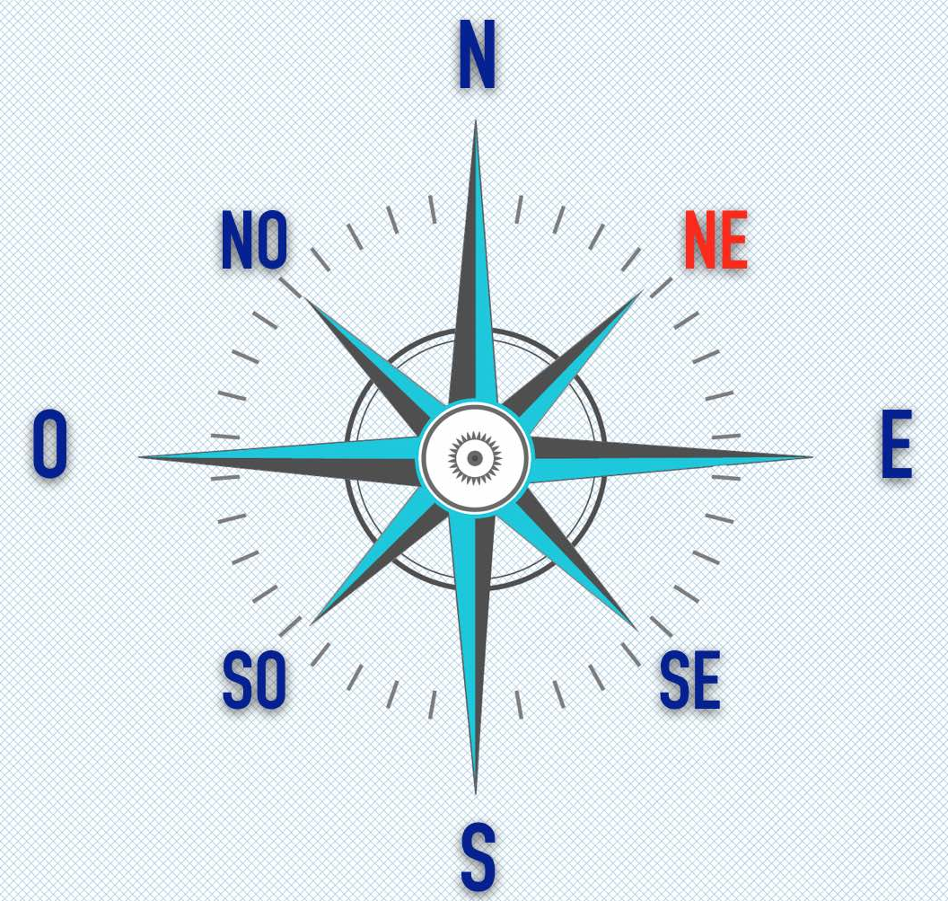
10 | 0 | 20 | 11
12 | 7 | 9 | 20
0 | 14 | 16 | 18

Slide 3
10 | 0 | 20 | 11
12 | 7 | 9 | 20
0 | 14 | 16 | 18
5
10
0

Slide 4
5
10
10 | 0 | 20 | 11
12 | 7 | 9 | 20
0 | 14 | 16 | 18
0
10
0
5

Slide 5
5
10
10 | 0 | 20 | 11
12 | 7 | 9 | 20
0 | 14 | 16 | 18
0
5
20
0
0
5

Slide 6
5
10
10 | 0 | 20 | 11
12 | 7 | 9 | 20
0 | 14 | 16 | 18
0
5
15
5
20
0
0
0

Slide 7
5
10
10 | 0 | 20 | 11
12 | 7 | 9 | 20
0 | 14 | 16 | 18
0
5
15
5
0
5
20
0
0
0
5

Slide 8
5
10
10 | 0 | 20 | 11
12 | 7 | 9 | 20
0 | 14 | 16 | 18
0
5
15
5
0
5
20
5
0
0
0
0
0
5

Slide 9
5
10
10 | 0 | 20 | 11
12 | 7 | 9 | 20
0 | 14 | 16 | 18
0
5
15
5
0
5
20
5
0
0
0
0
0
Z = 5 * 10 + 10 * 0 + 5 * 7 + 15 * 9 + 5 * 20 + 5 * 18

Slide 10
Z = 5 * 10 + 10 * 0 + 5 * 7 + 15 * 9 + 5 * 20 + 5 * 18
Z = 50 + 0 + 35 + 135 + 100 + 90
Z = 410

